Slide 1
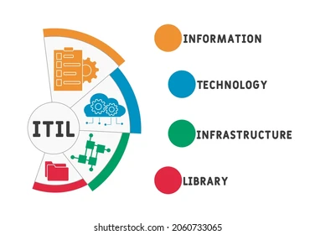

Slide 2
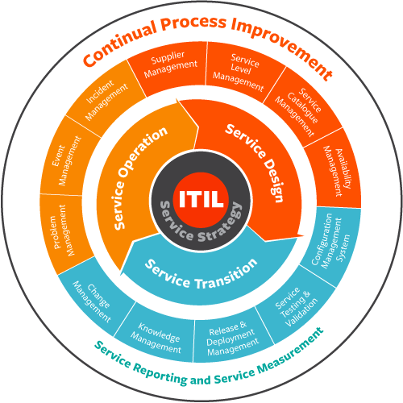
Business Goals
The challenges for IT managers are to co-ordinate and work in partnership with the business to deliver high quality IT services.
This has to be achieved while adopting a more business and customer oriented approach to delivering services and cost optimization. The primary objective of Service Management is to ensure that the IT services are aligned to the business needs and actively support them.
It is imperative that the IT services underpin the business processes, but it is also increasingly important that IT acts as an agent for change to facilitate business transformation.
All organizations that use IT depend on IT to be successful. If IT processes and IT services are implemented, managed and supported in the appropriate way, the business will be more successful, suffer less disruption and loss of productive hours, reduce costs, increase revenue, improve public relations and achieve its business objectives.

Slide 3
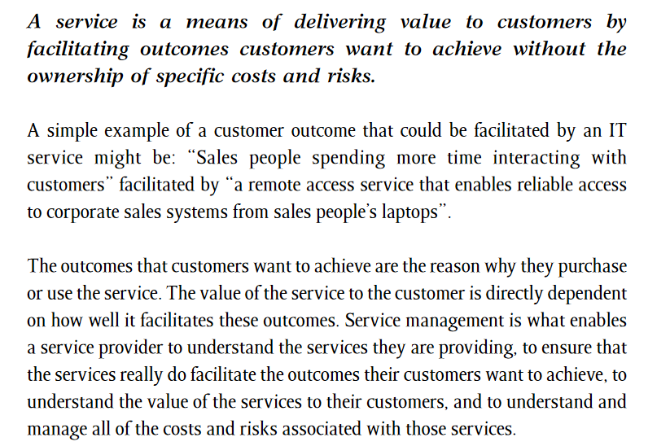
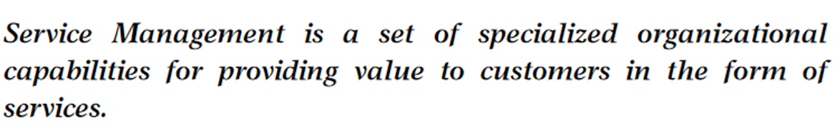
What is a Service?

Slide 4
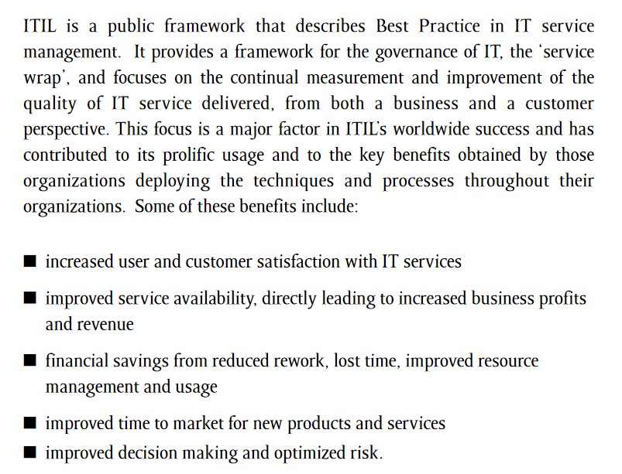
IT Infrastructure Library

Slide 5

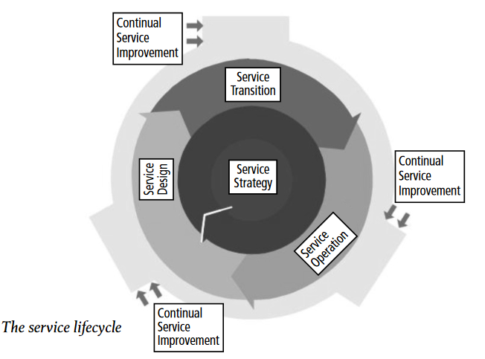

Slide 6
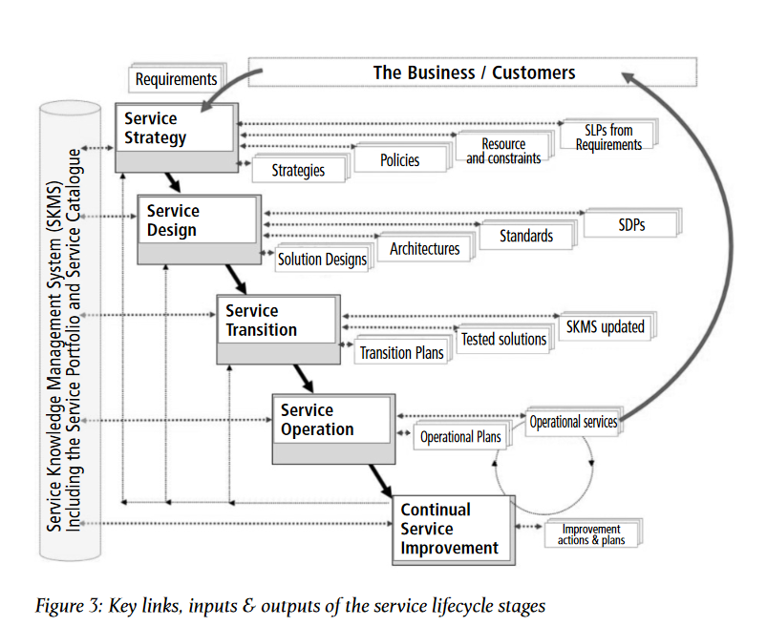
Service Life Cycle Stages

Slide 7
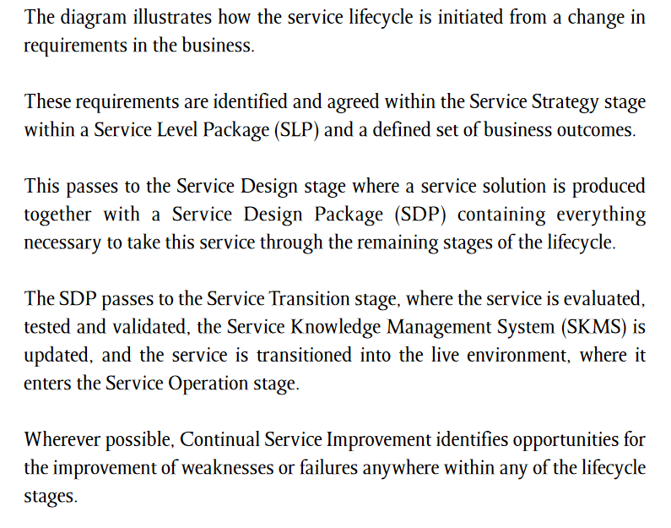

Slide 8
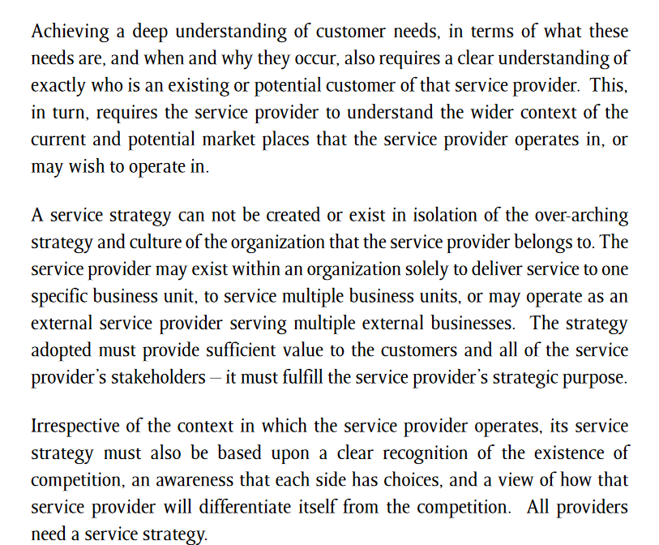
Why A Service Strategy Is Required?

Slide 9
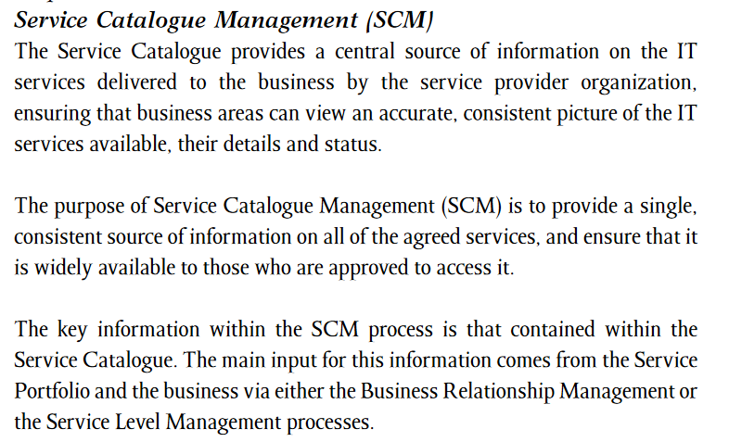
Service Catalogue Management(SCM)

Slide 10
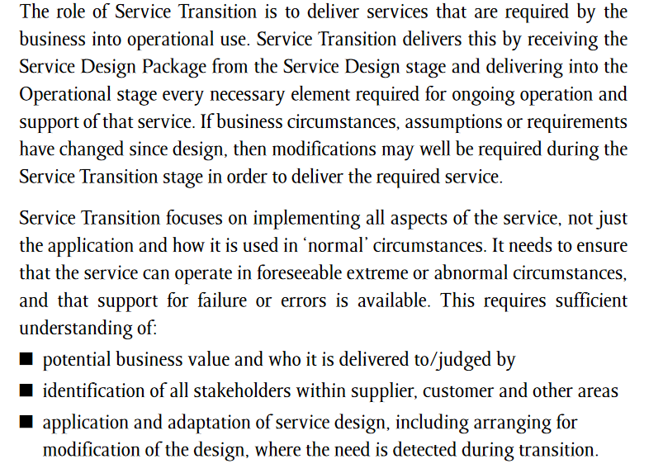
Service Transition

Slide 11
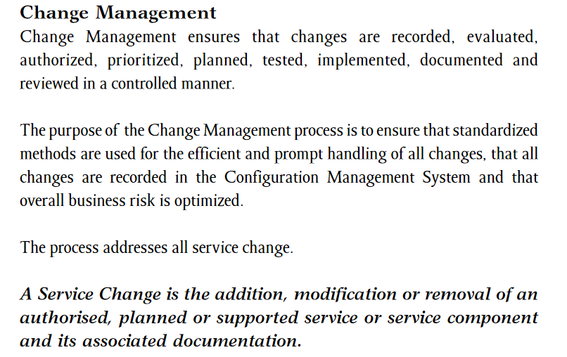
Change Management

Slide 12
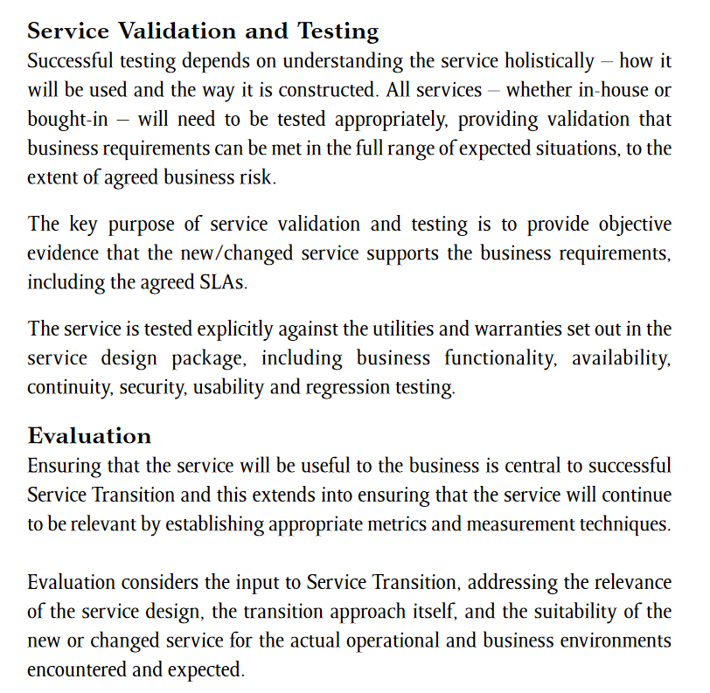
Service Validation and Testing

Slide 13
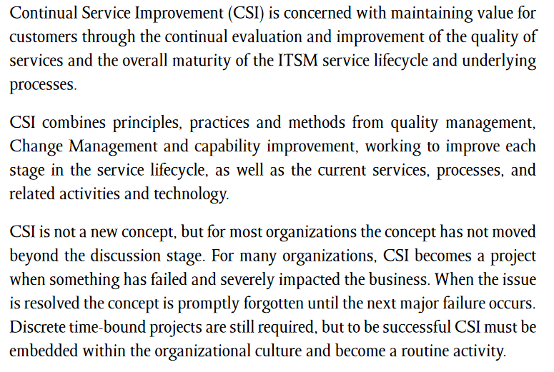
Continual Service Improvement

Slide 14

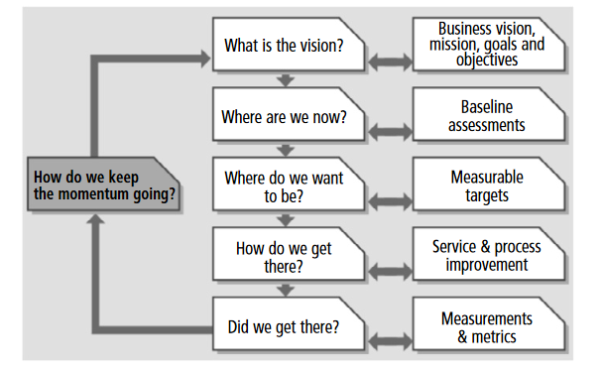

Slide 15

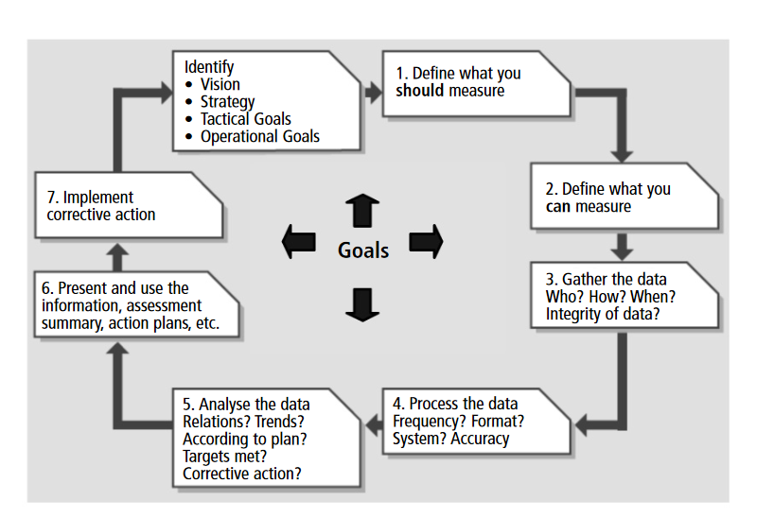

Slide 16
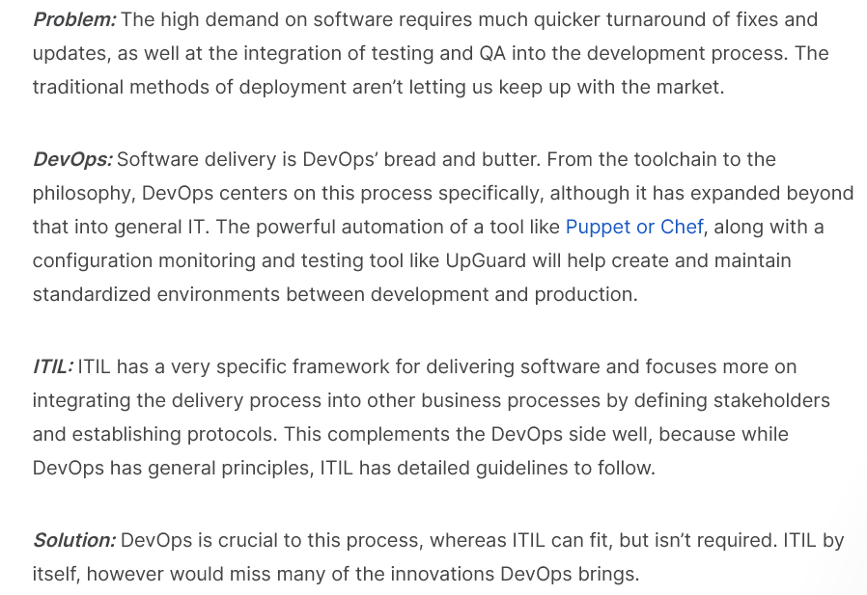
Cases

Slide 17
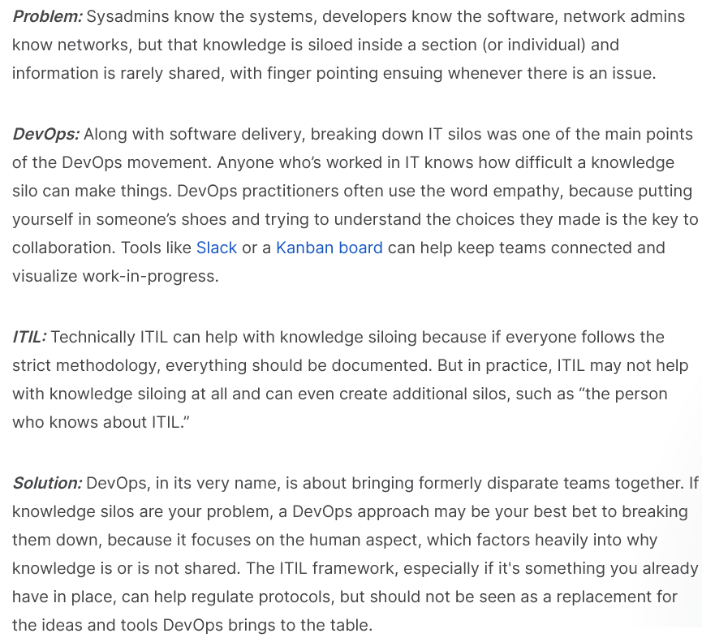
Cases

Slide 18
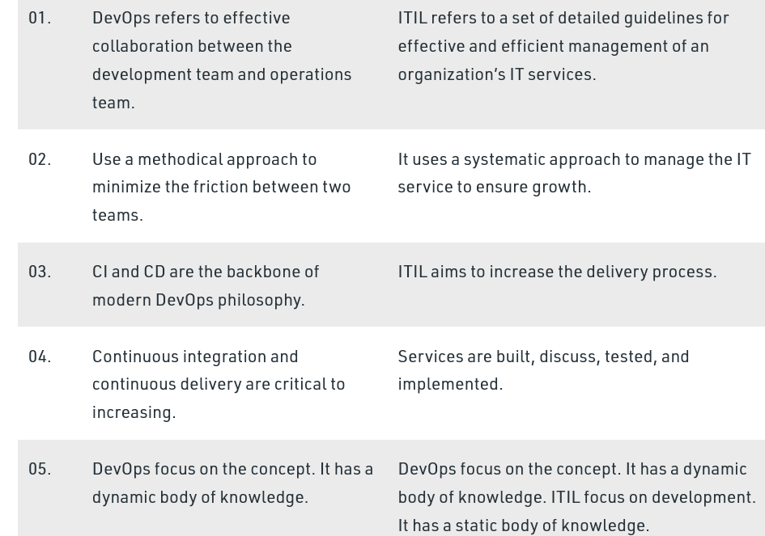
Dev Ops Vs ITIL

